Slide 1
A Flutter Package for Real-Time Mobility Feature Computation
Thomas Nygaard Nilsson, s144470
Master’s Thesis Defence
July 1st 2020

Slide 2
Mobility Features
Features derived from location data over time
Capture the users mobility patterns
Where they have been, when, for how long?
Where they have moved
What did they do?

Slide 3
Clinical Background
Depression and bipolar disease
Relapses
Prevent relapses
Collecting patient data
Mental state of user with PHQ-9 questionnaire
Derive behaviour over time
Predict relapses
Self-reporting (subjective data)
Mobility Features correlate with PHQ-9
(Saeb2015, Palmius2017, Canzian2015)
Goal: Supplement prediction with objective data

Slide 4
Mobile Sensing
Infer user state from objective sensor data
Mobile sensing for depression
Location data
Accelerometer
Sleep data
Deep dive into location data for depression

Slide 5
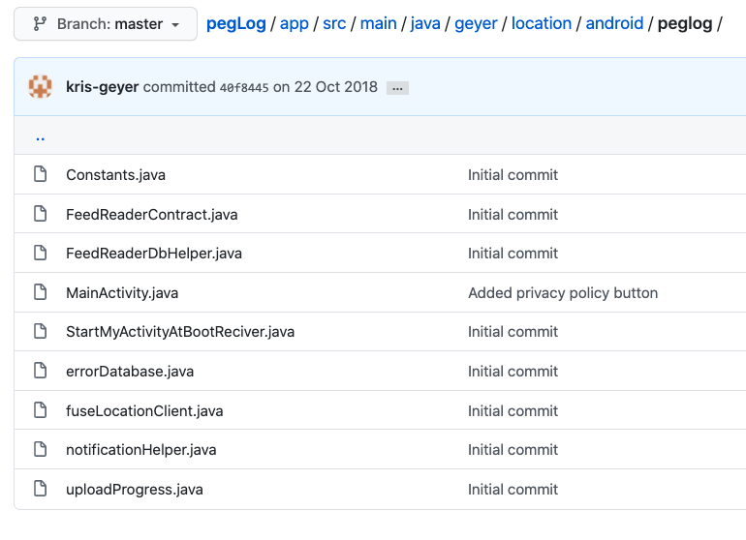
Problem Statement (1)
Researchers wanting to build on top on previous research
Existing contributions hard to reproduce (source code)
Sometimes not released
Deprecated fast
Released as apps
Github Repository, pegLog, 2020 https://www.ncbi.nlm.nih.gov/pmc/articles/PMC6877492/

Slide 6
Problem Statement (2)
Algorithms are not real-time compatible
Offline processing
Online processing (real-time)
Real-time
At any time
Computable on the device
Solution
Software package for mobile health researchers
Real-time computation
Data stored on the phone

Slide 7
Research Questions
Which mobility features are relevant to include in a software package?
How can these features be computed in real-time, on a smartphone device?
How does the design of such a software package look like?

Slide 8
Q1 Which mobility features are relevant to include in a software package?
Saeb2015 found a correlation between certain features and the PHQ-9 score
High PHQ-9 score = depressed
Feature | Correlation with PHQ-9 | Description
RI: Routine Index | - | Lacking a routine
HS: Home Stay | + | Staying at home a lot
LV: Location Variance | + | Varying your location a lot
NE: Normalized Entropy | + | Staying at many places for an equal amount of time

Slide 9
Feature Discussion
Duality between the features
Staying at home a lot is a form of routine
Palmius2017 finds that features vary on a participant-basis
Having a full-time job == routine != not depressed
One can choose to stay home for non-pathological reasons

Slide 10
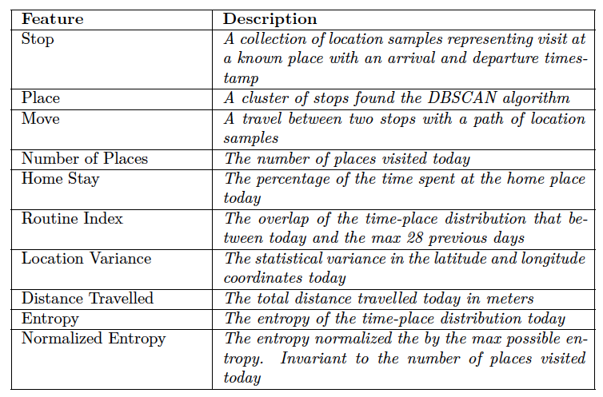
Feature Overview
NE derived from Entropy, derived from Stops, etc.
Include all descendant features
Stop, Move, Place
Directly derived from location data
Other features derived from these

Slide 11
Q2 How can these features be computed in real-time, on a smartphone device?
Hour Matrix
Real-time
Re-define feature algorithms to work on an incomplete dataset
Meaningful
Home Stay, divide by current hour of the day, rather than 24 hours
Routine Index, ignore unobserved time slots
On a smartphone
Routine Index requires historical data
Solution: Store stops on disk

Slide 12
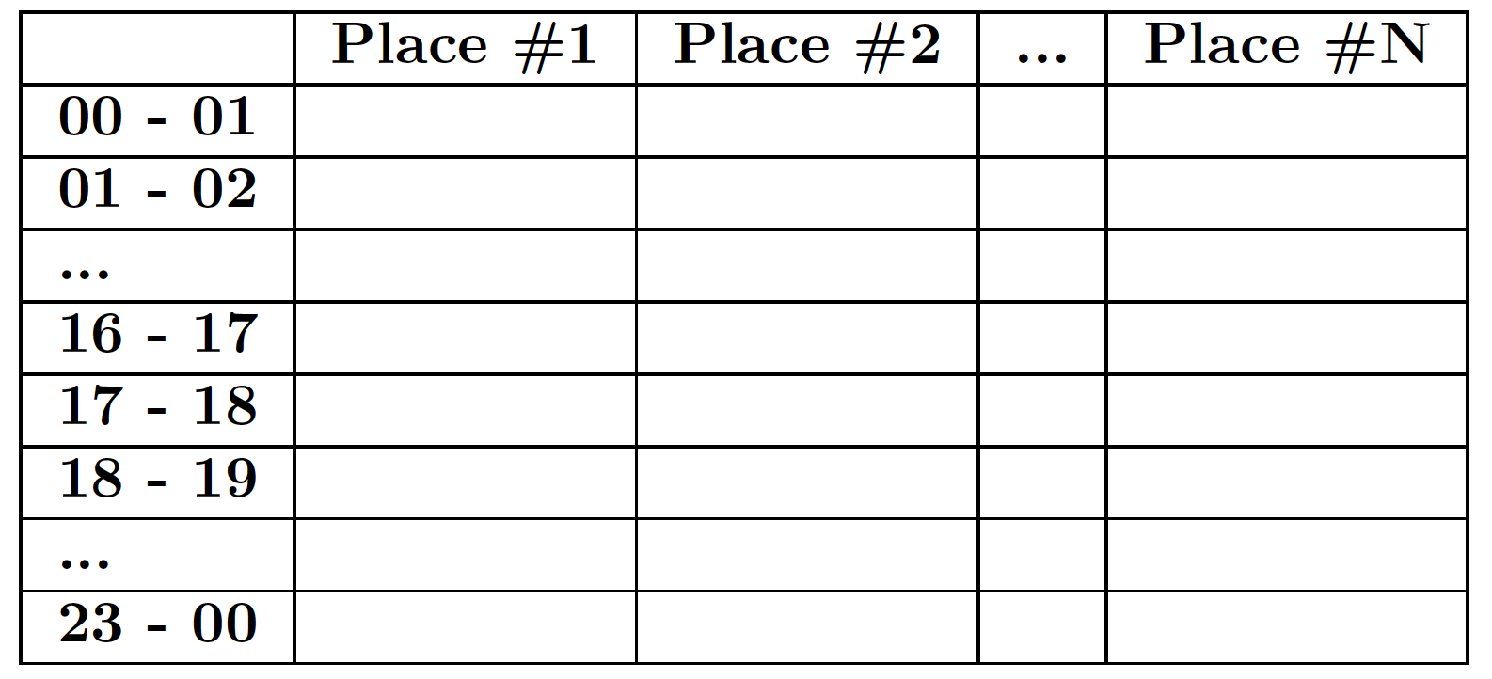
Hour Matrix
The distribution of time spent at the known places
Rows: Hour-slots in the day (24)
Columns: The known places
Each row represents the place distribution for an hour
Can maximally sum to 1
Constructed from a set of Stops
Stop arrival: Start hour-slot
Stop departure: End hour-slot
Routine Matrix
Average Hour Matrix of recent days
RI = overlap(Routine, Today)

Slide 13
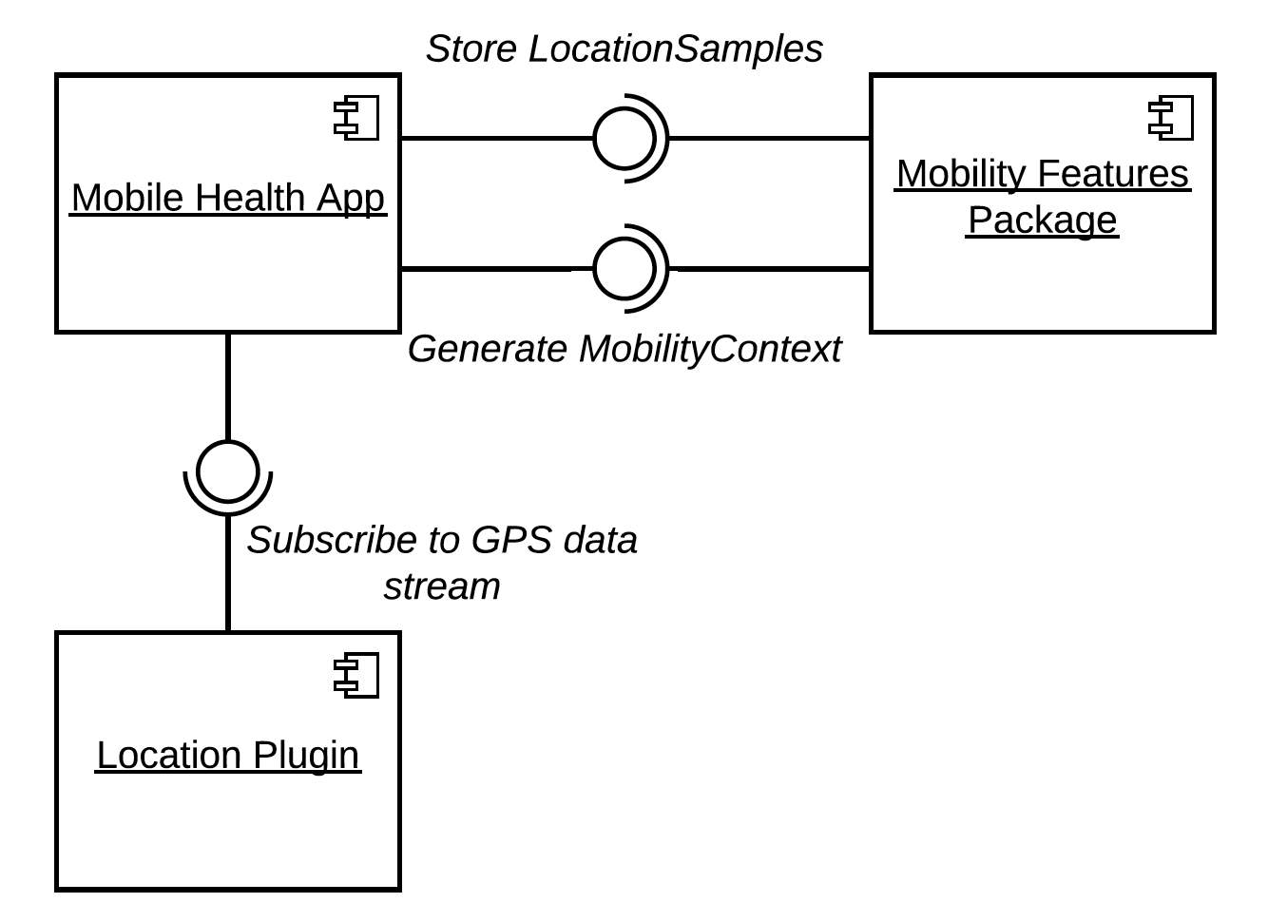
Q3 How does the design of such a software package look like?
Implemented in the Flutter framework (Dart language)
Features computed with 3 lines of Dart code
Programming interface hides the implementation from the programmer
Makes it easier to use
Location data collection done via a separate plugin
Gives programmer flexibility
Dependency issues avoided
Package maintenance much easier

Slide 14
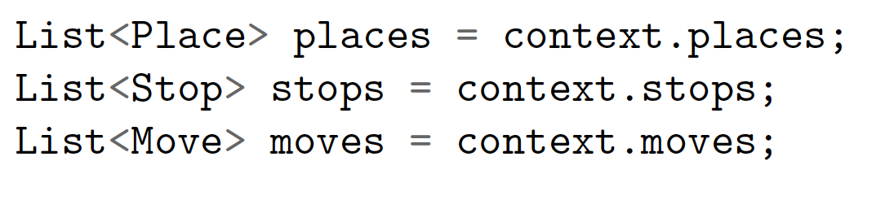
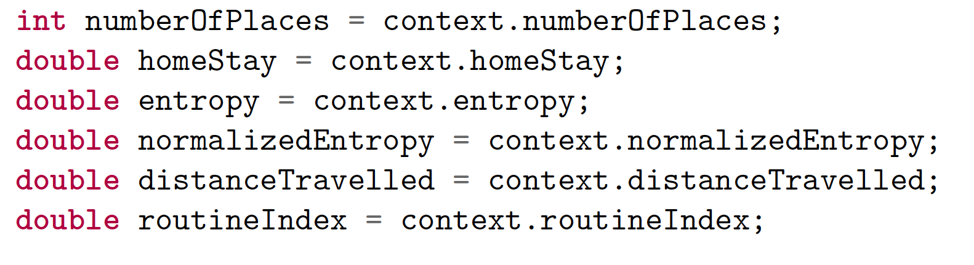
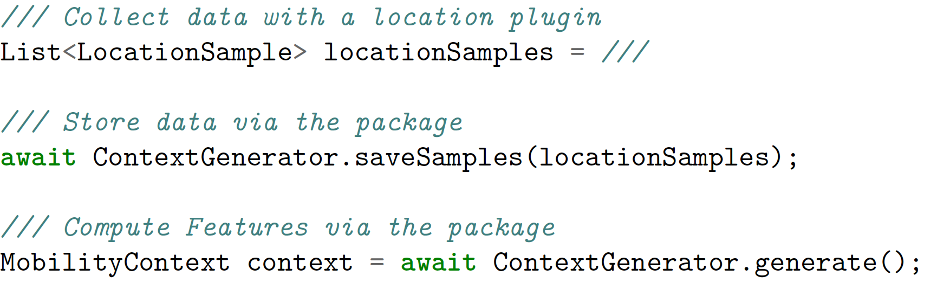
Using the Package
The package is published at https://pub.dev/packages/mobility_features

Slide 15
Field Study
The package was evaluated in a small field study
’Alpha’ test, no diagnosed participants
10 participants, 3 weeks
Computed features vs subjective questionnaire data

Slide 16
Field Study Application (Installation)

Slide 17
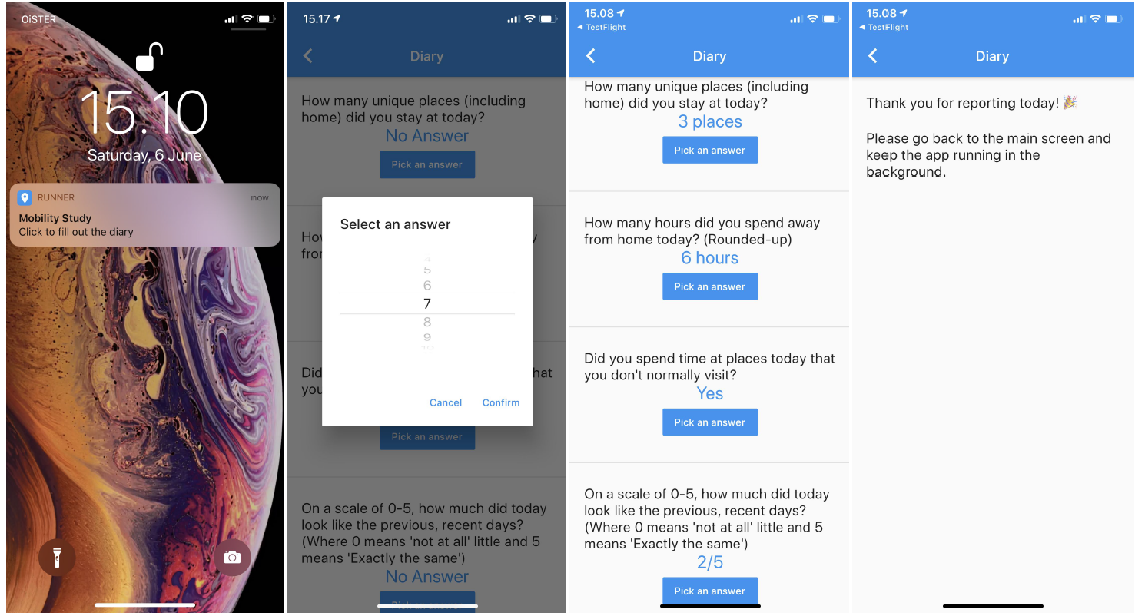
Field Study Application (Questionnaire)

Slide 18
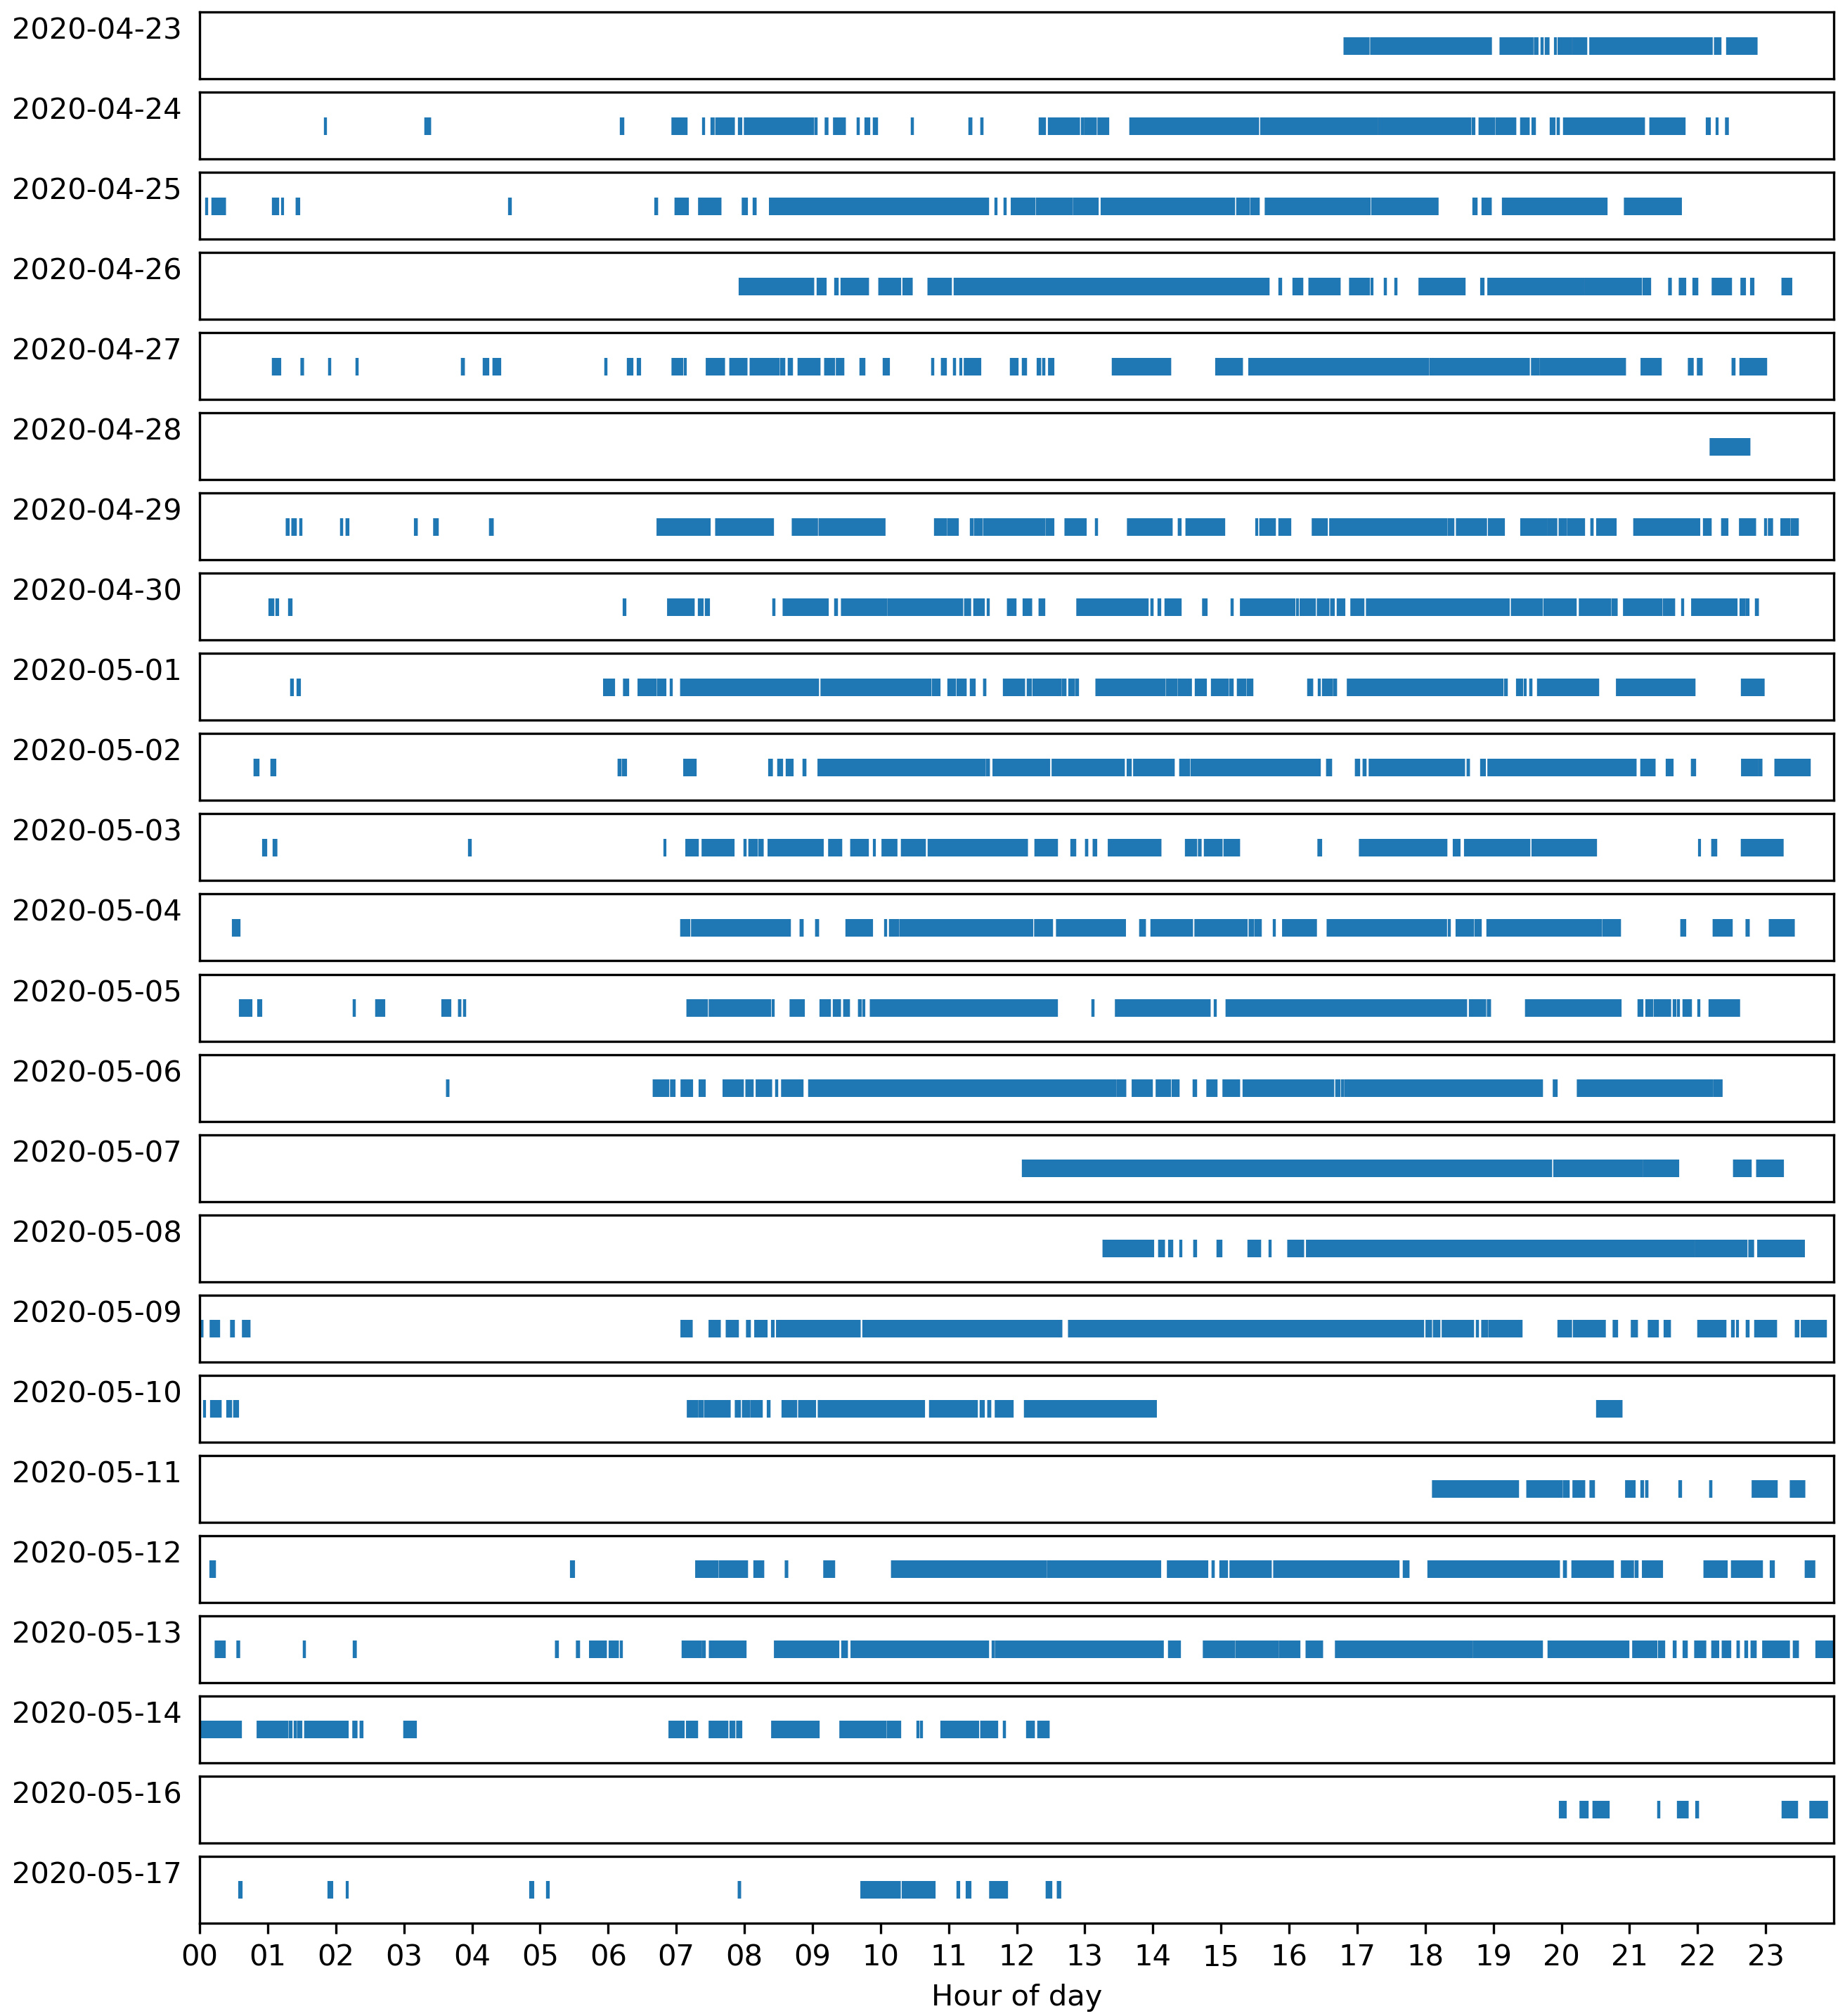
Results – Data Gaps
00:00-07:00: Consistent gaps
Not necessarily a problem if place does not change
Home stay can still be evaluated
Likely due to inactivity
07:00-23:59: Inconstistent gaps
Can impact algorithms a lot
Another dimension to the algorithms is added (did we sample?)

Slide 19
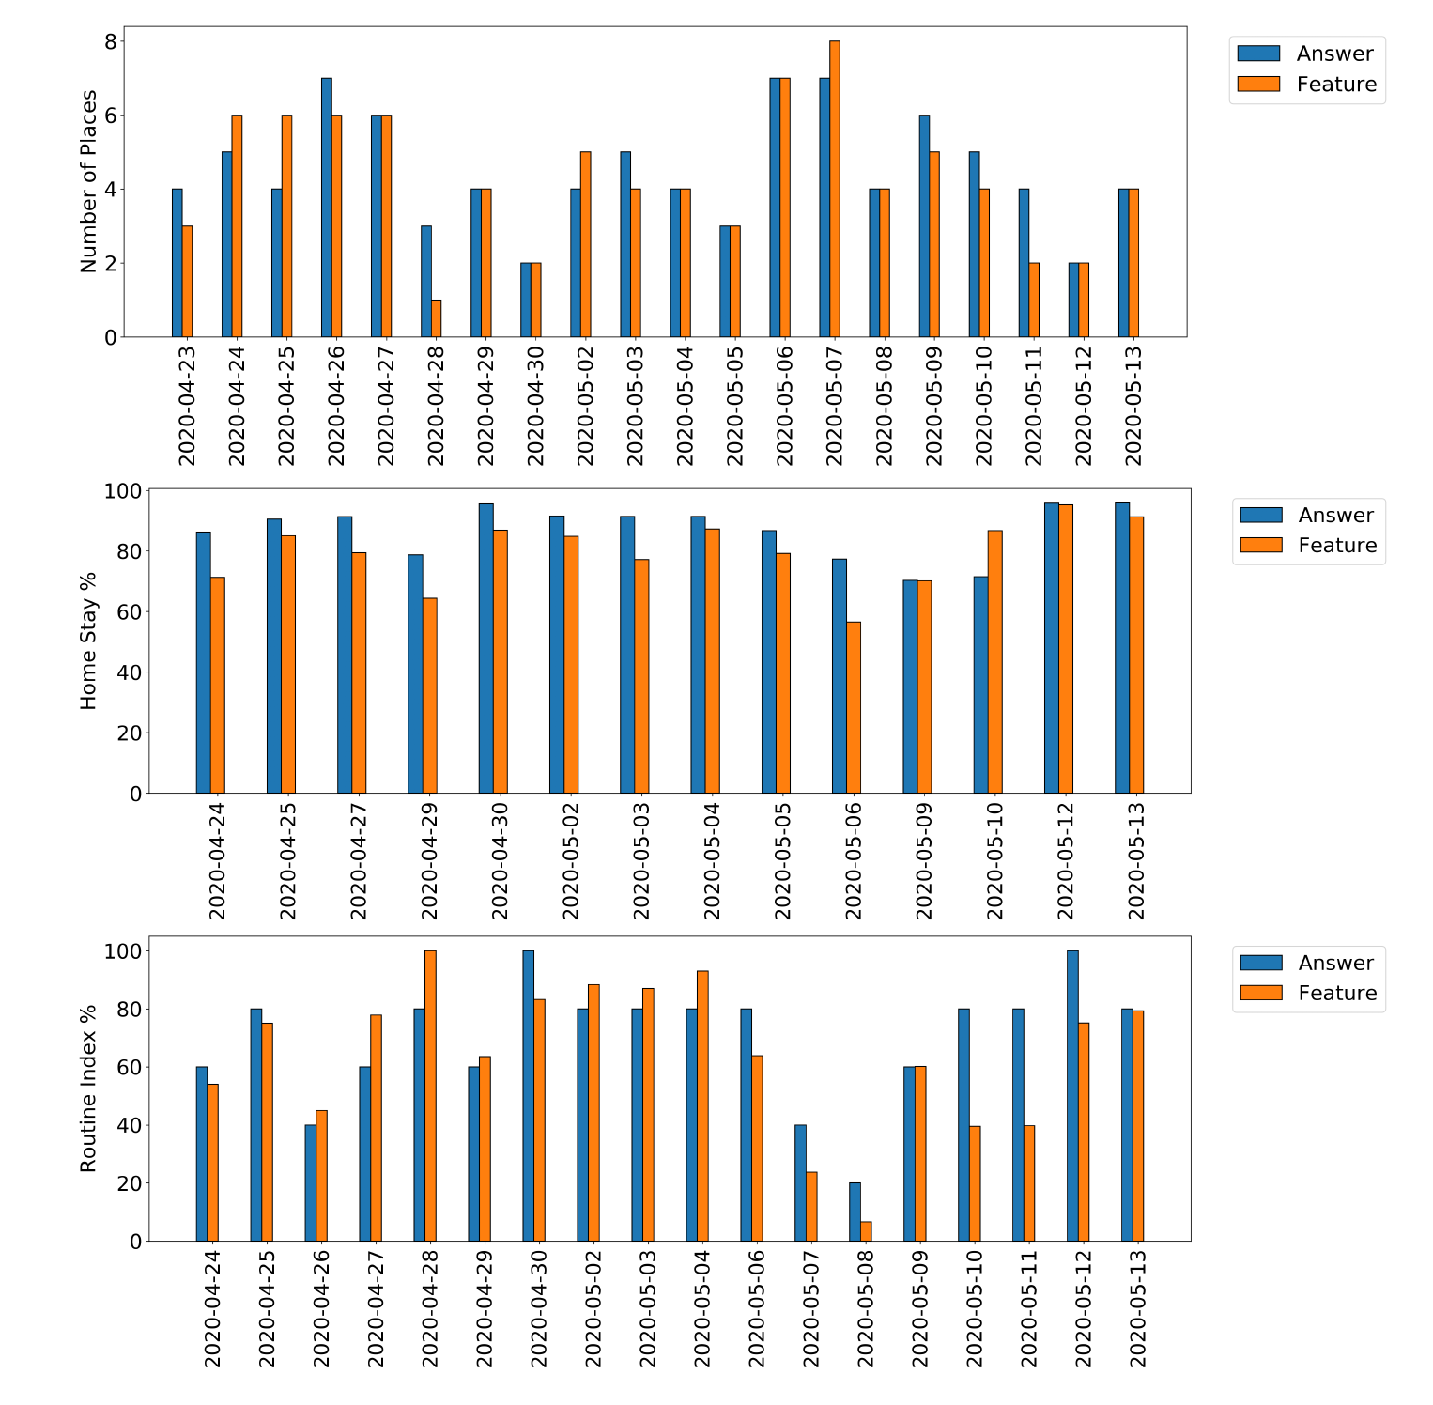
Results – Author’s Features
In general a high correspondance
Author had certain advantages
He knew how the features were computed
Had a new phone
Made sure the phone was tracked constantly

Slide 20
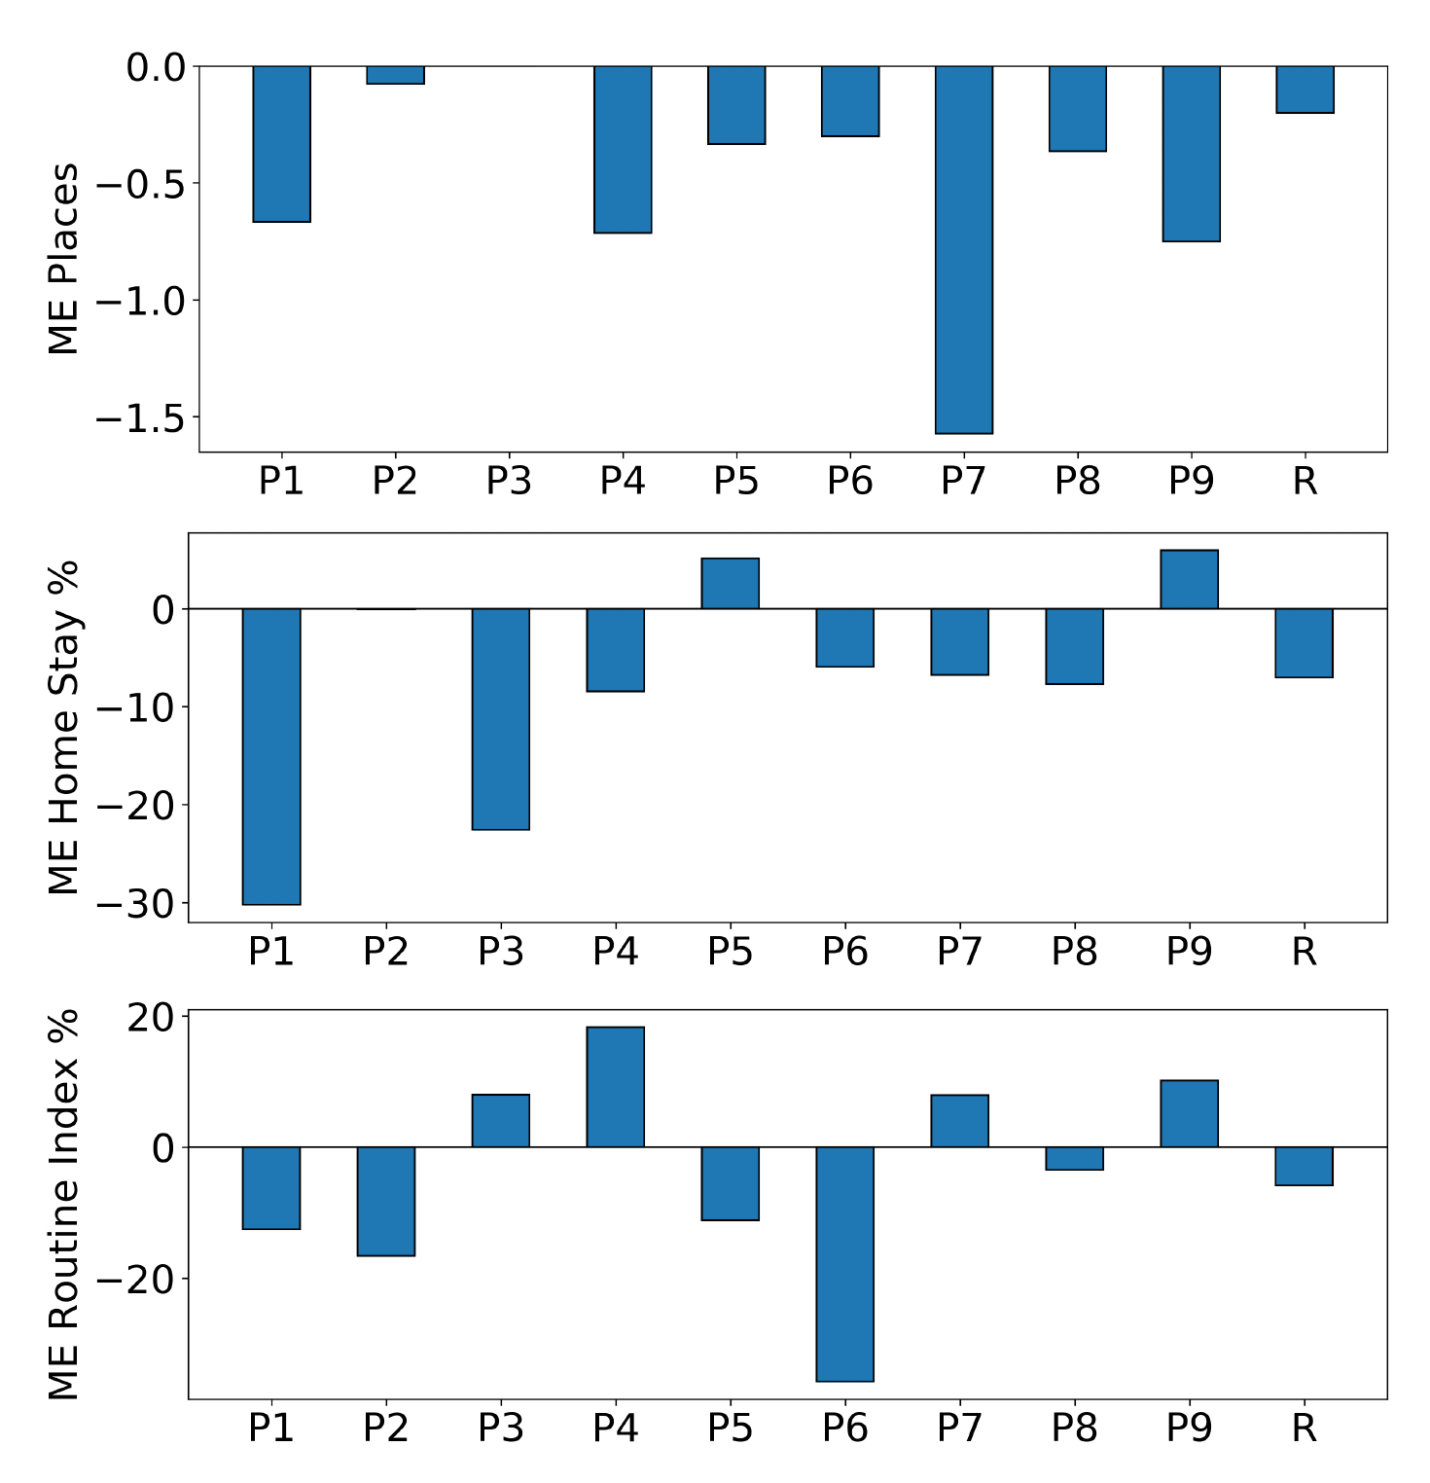
Results – Error Computation
RMSE across all participants (see table)
Routine Index: 20% = 1 step on the scale
Mean Error for all participants
Positive mean error: feature overshoots
Negative mean error: feature undershoots
Significant gaps in the data were found

Slide 21
Future Work – Missing Data
Gaps in the data make it hard to compute features reliably
Solution: Impute data
Stops are already being stored
Fill empty timesplots using Routine Matrix

Slide 22
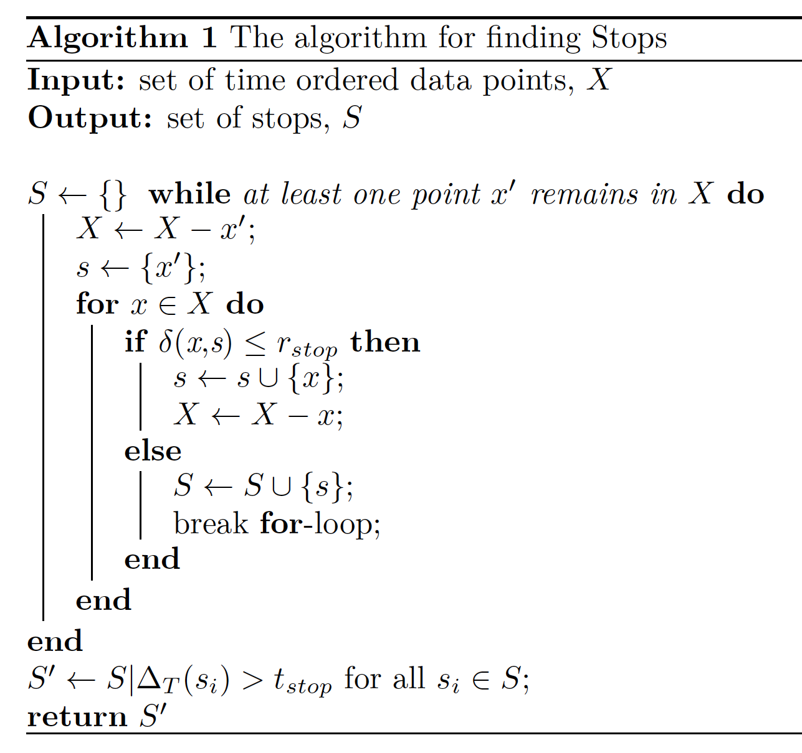
Finding Stops
Distance grouping
Cuttone et al. 2014
Input: A set of location samples
Group samples based on distance
Create Stop when median coordinates of current group is too far away from next sample
Location = median of group
Arrival = min timestamp of group
Departure = max timestamp of group
Filter the stops based on duration
Throw away Stops shorter than 3 minutes

Slide 23
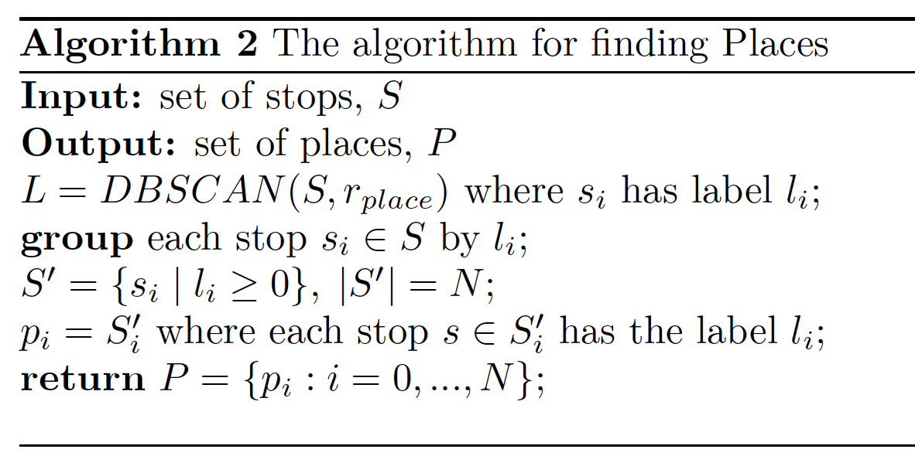
Finding Places
Cluster found stops with DBSCAN
Cuttone et al. 2014
Epsilon = 50 meters
Min. points = 1
Each stop is assigned a label (place id)
Group stops by label
If label == -1, then the stop is considered noise
Create a place for each group
Place location is the median of the group’s locations

Slide 24
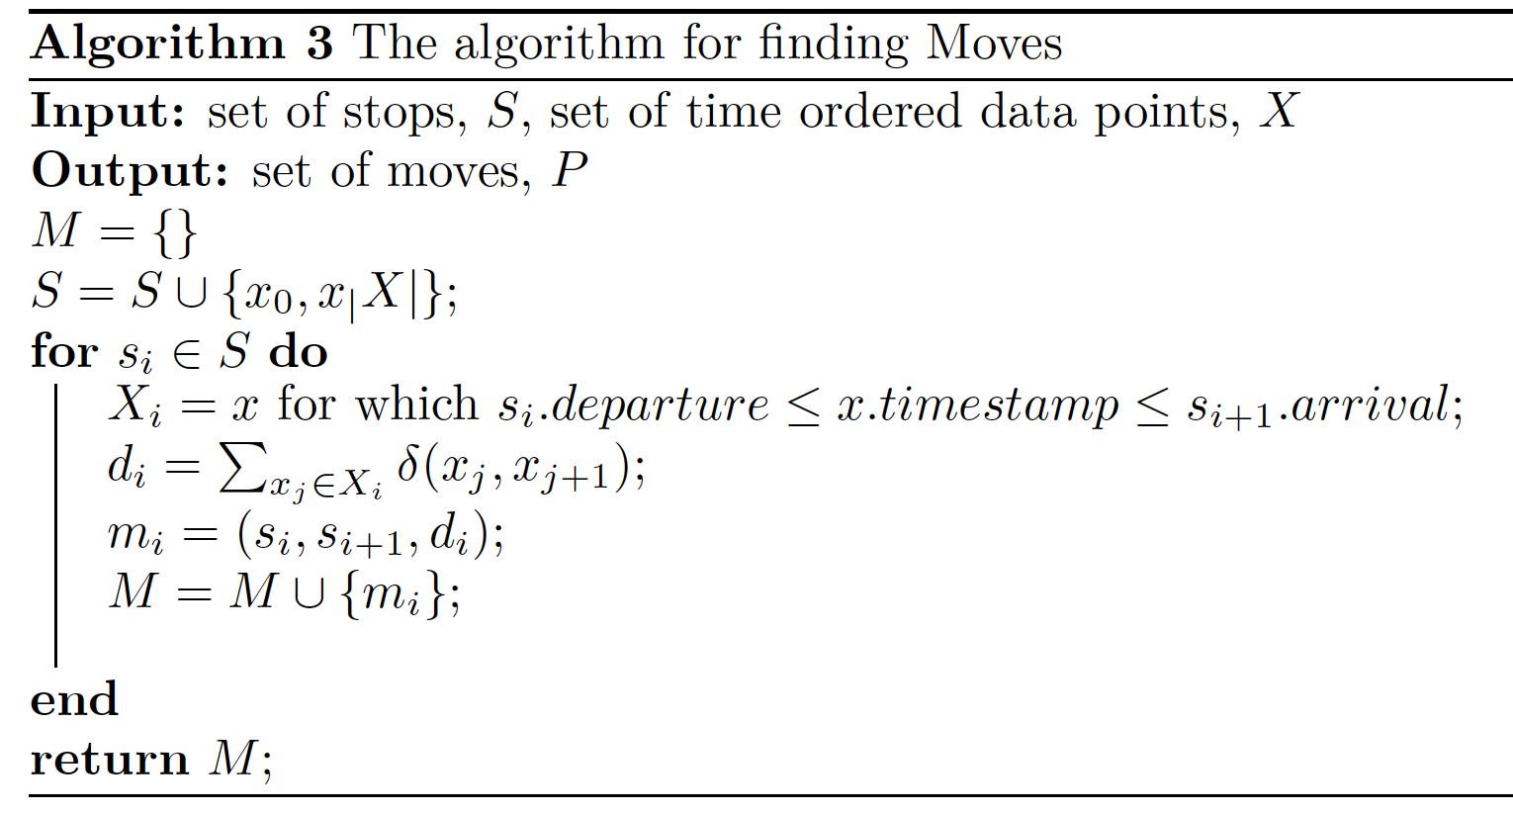
Finding Moves
Create two fake stops
First and last sample (wrt. Timestamp)
For each pair of stops
Find all samples collected between the two stops
Compute the distance of the path taken
Create the Move from the two stops and the computed distance

Slide 25
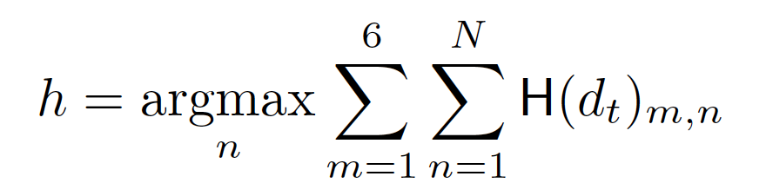
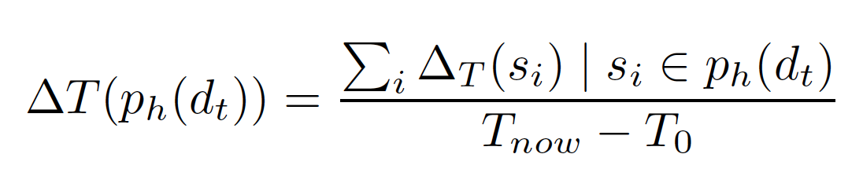
Home Stay
Computed from the Hour Matrix of today
Identify home cluster
Argmax over the columns in the Hour Matrix
Column with the highest value = home place id

Slide 26
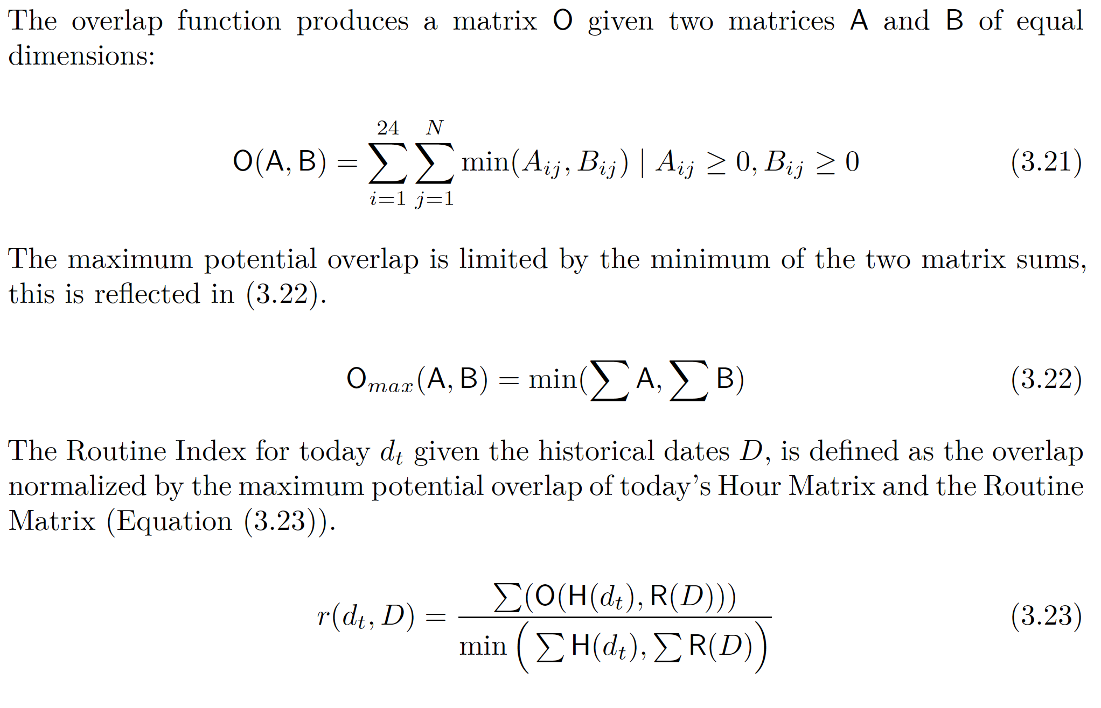
The Routine Index (1)

Slide 27
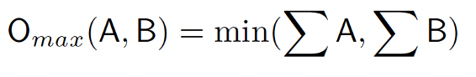
The Routine Index (2)
The maximum overlap computed as minimum of the two matrix sums
Will disregard unobserved timeslots
Ex 1: timeslot is later than right now (data is not yet observed)
Ex 2: timeslot is empty due to gaps in the data
Ideally we could just set this to 24 hours
There will always be gaps in the data
i.e the time sampled in total will be less than 24 hours

Slide 28
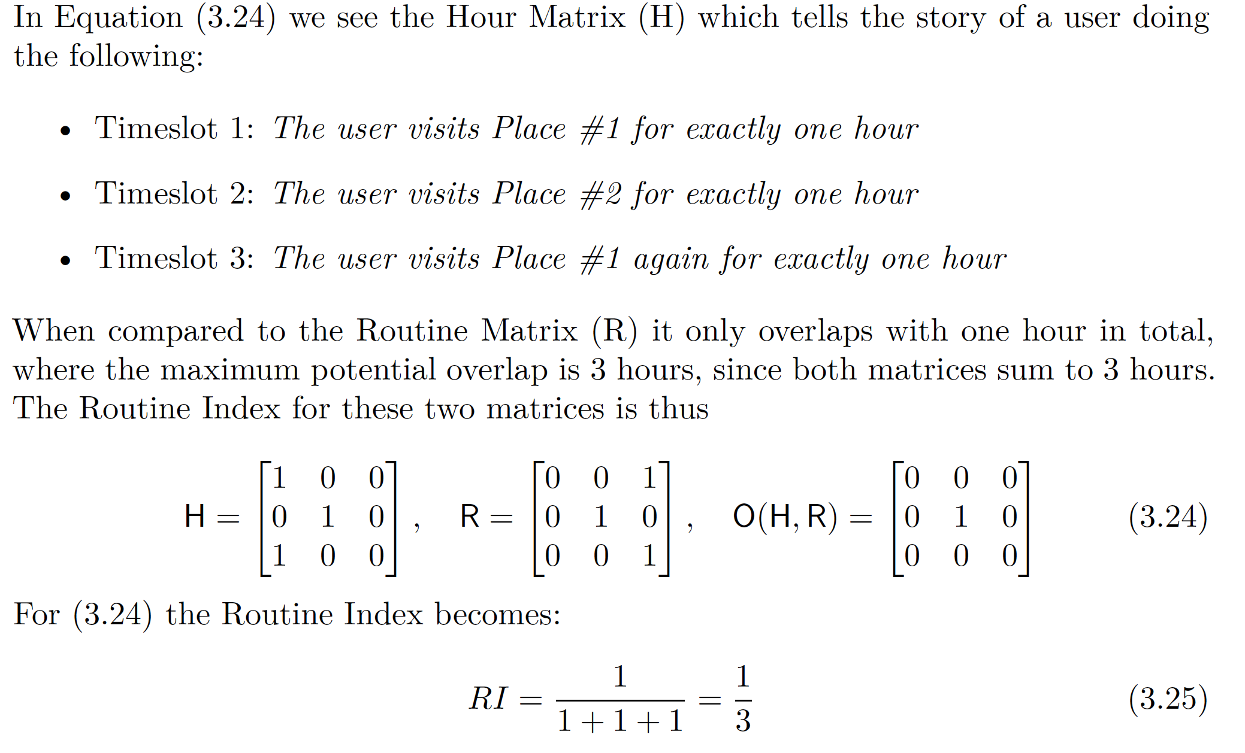
The Routine Index – Example 1

Slide 29
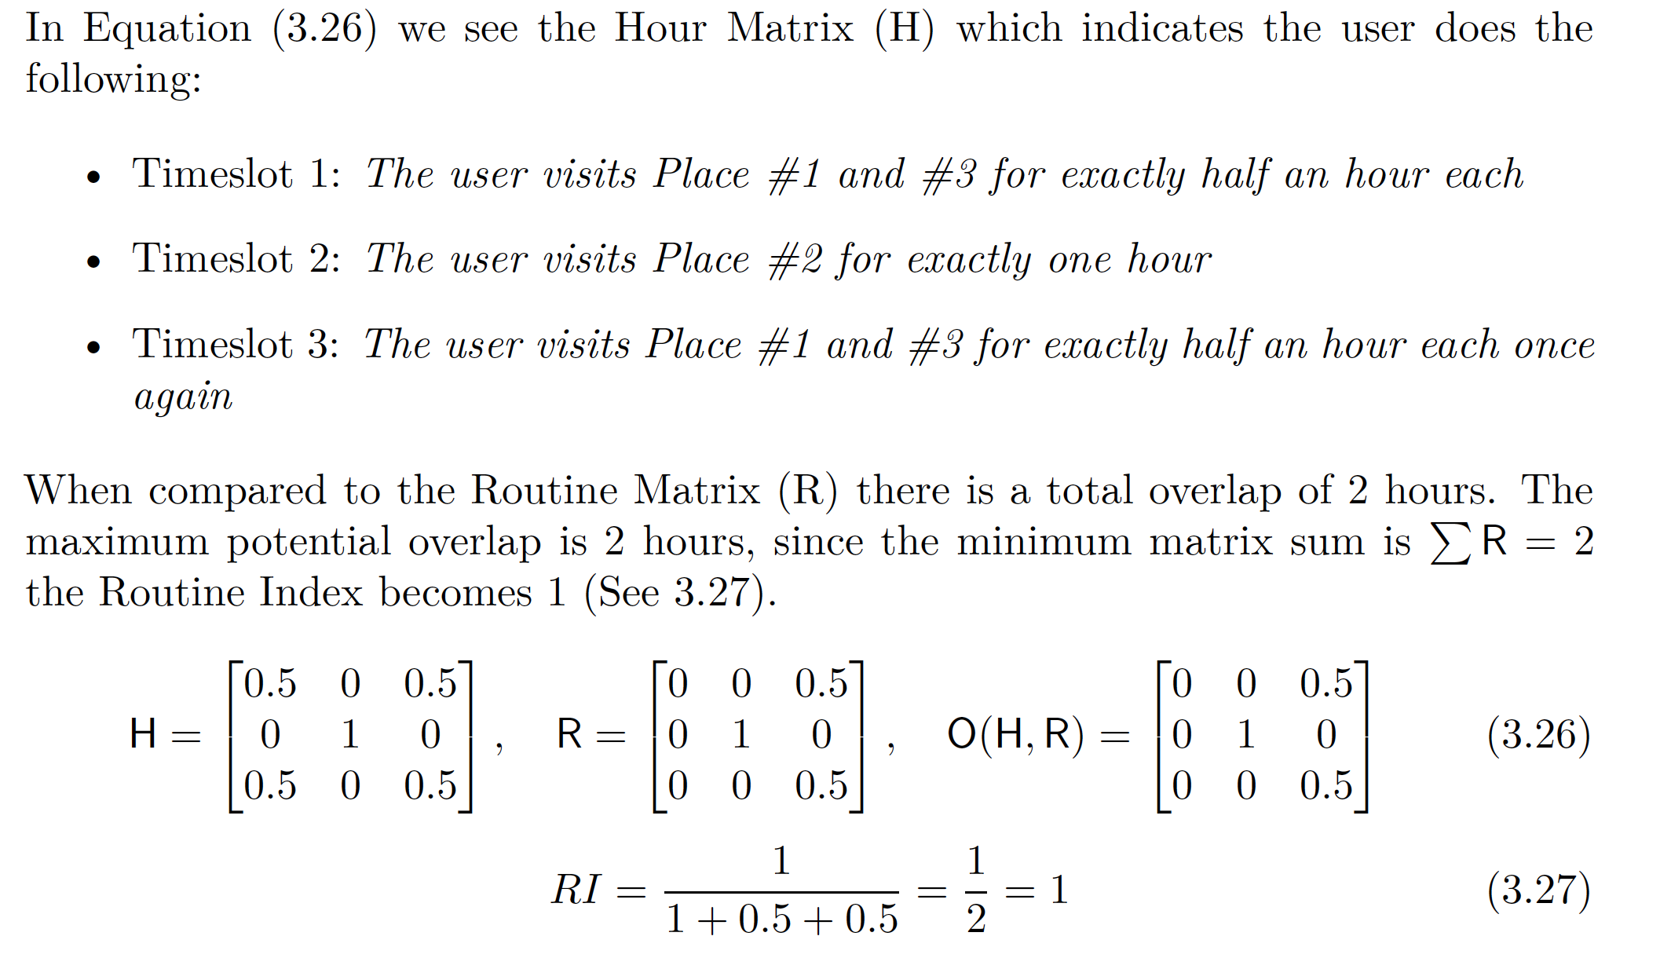
The Routine Index – Example 2

Slide 30
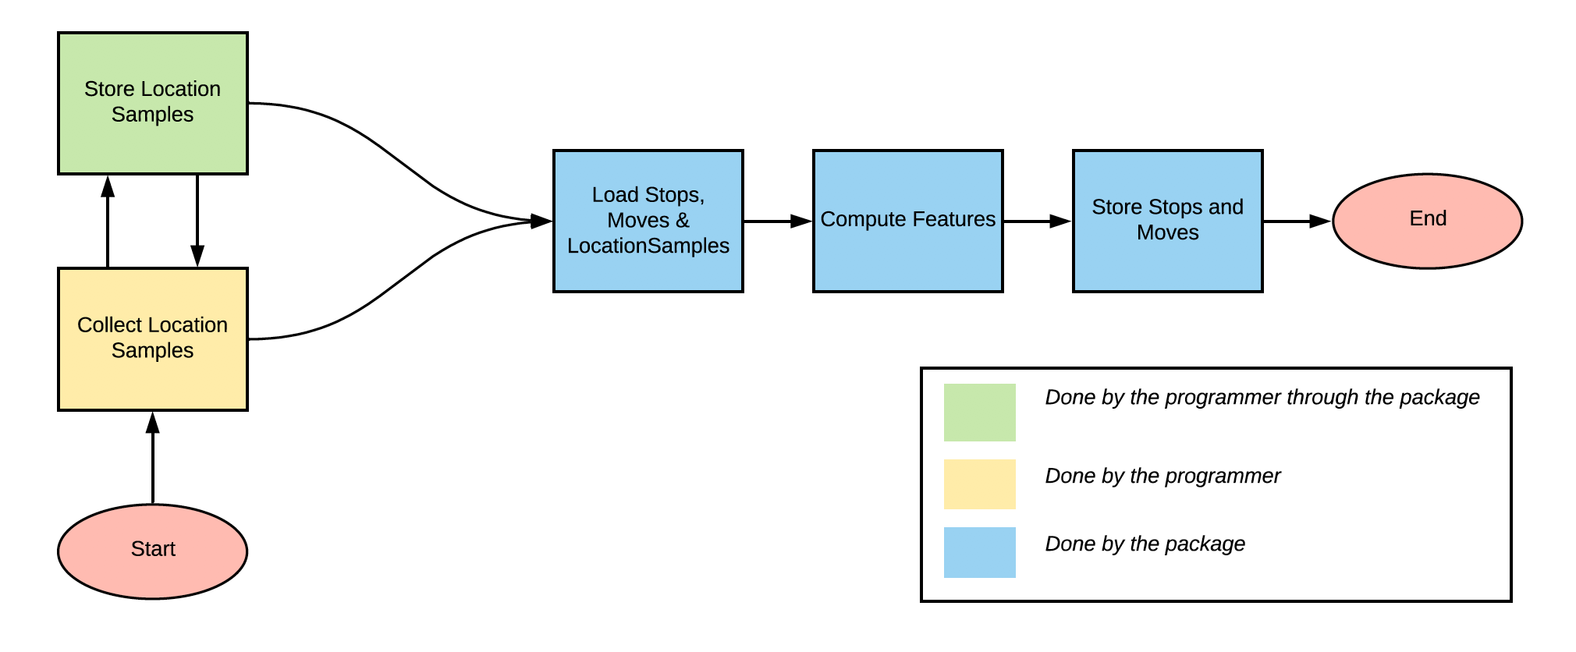
Software Design
What is done by the package
Managing samples already saved
Computing features
Storing features
What is done by the programmer
Collecting location samples
Storing the location samples through the package API

Slide 31
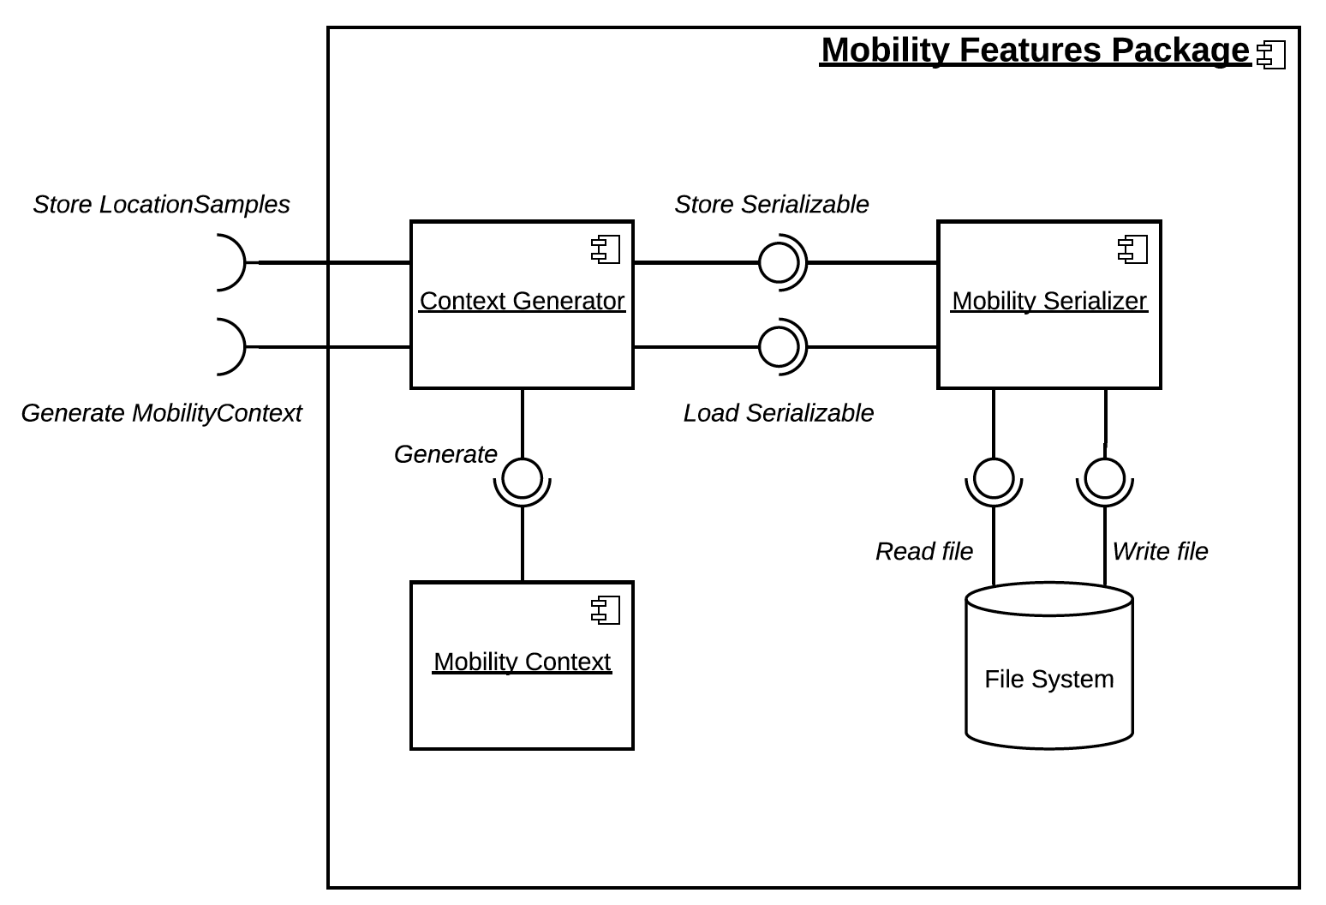
Software Design – Internal Components
Context Generator
The component the programmer will interface with
Generates contexts
Stores location samples
Mobility Serializer
Used by the Context Generator
Load and store data
Stop, Move, Location Sample
Mobility Context
Generated by the Context Generator
Contains all the features

Slide 32
Software Design – External Components
Mobile Health App
Collects data via an external plugin
Stores location samples via the package
Computes features via the package
Location Plugin
External component for collecting location data
Mobility Features Package
Provides the ContextGenerator class as interface

Slide 33
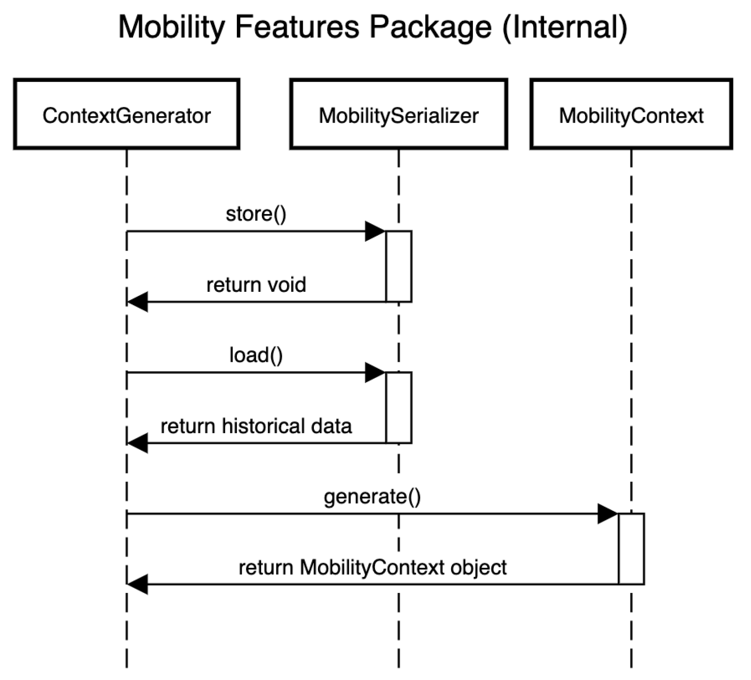
Software Design – Internal Sequence Diagram
store()
Data can be a Location Sample, Move, or Stop
Storage of location samples is directly triggered by the user
Storage of stops/moves is triggered by computation of features
load()
Triggered by feature computation
Loads Stops, Moves and Location Samples
generate()
Feature computation

Slide 34
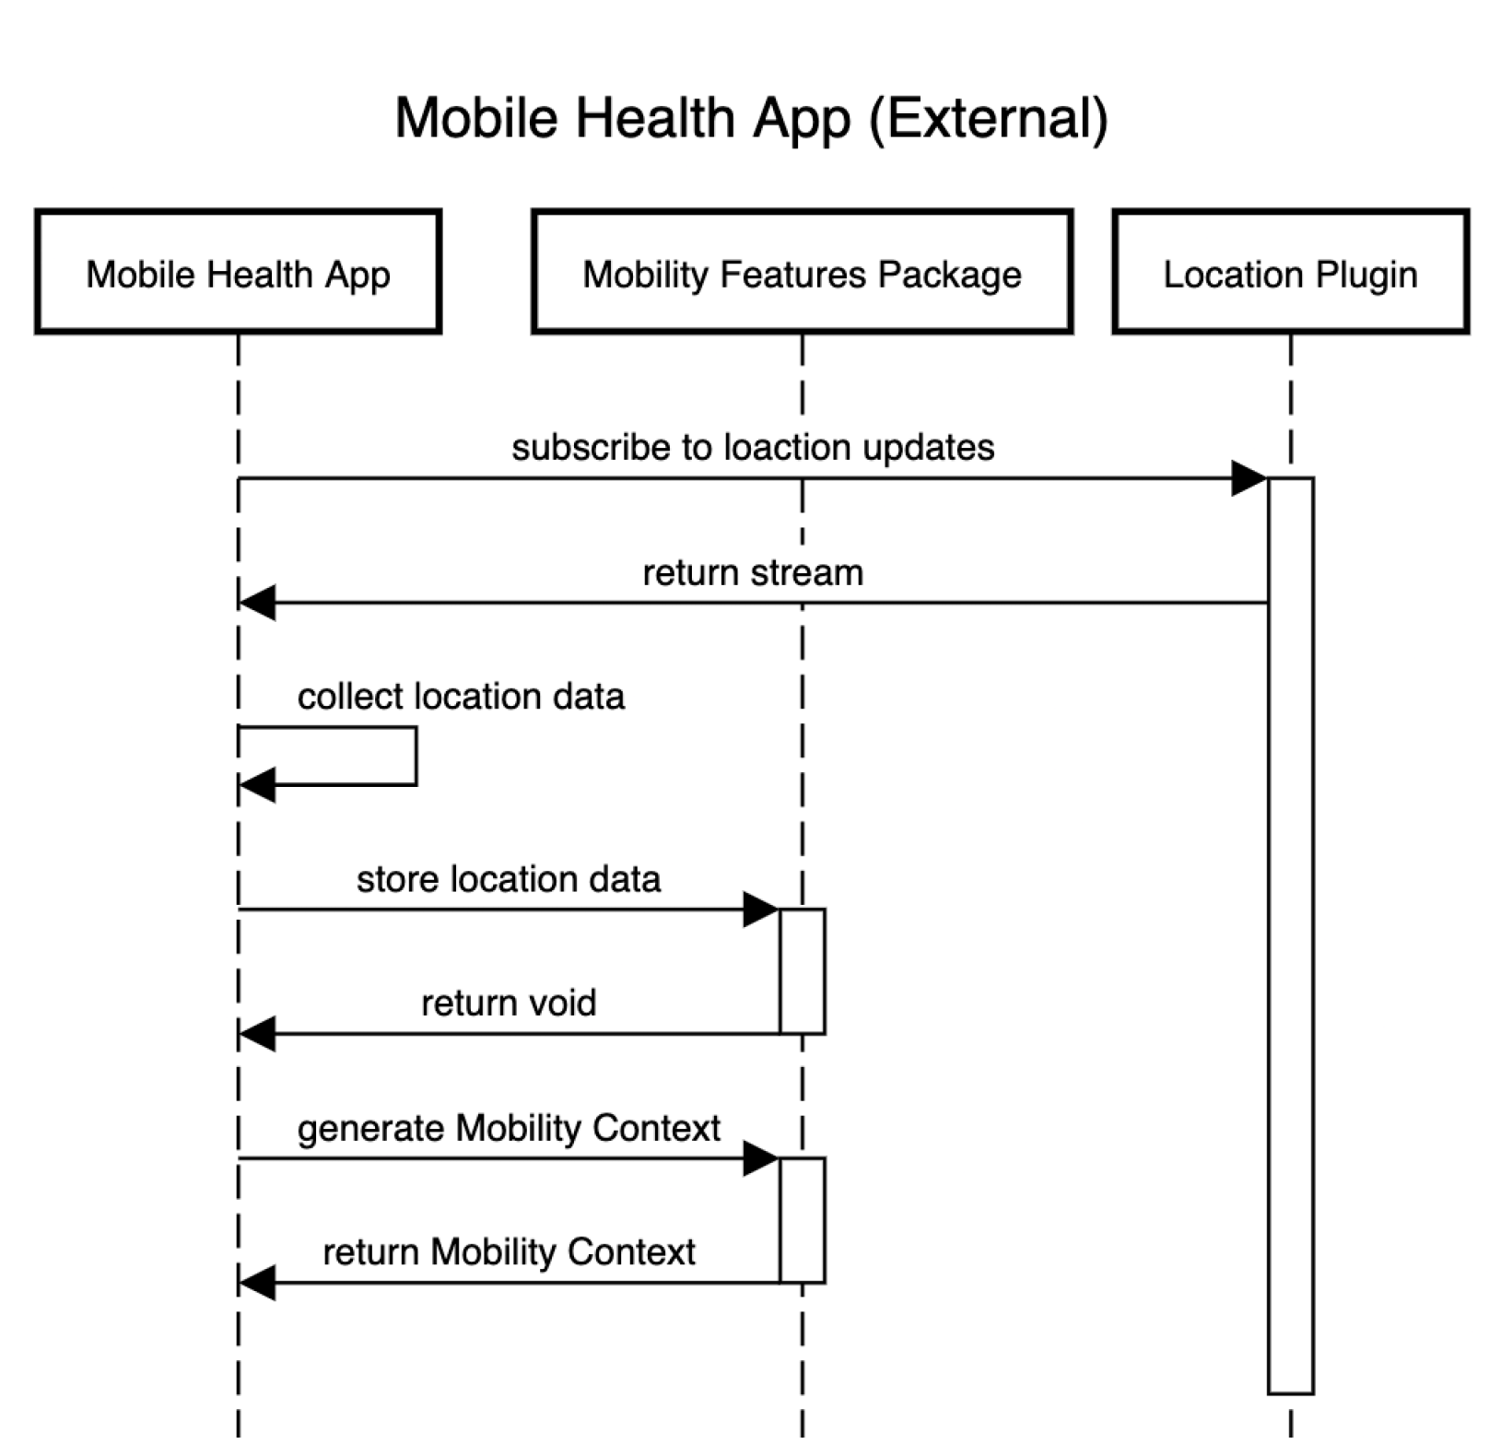
Software Design – External Sequence Diagram
Subcribing to location updates
The location plugin will continuously previded the Mobile Health App with location DTOs
Collecting location data
The Mobile Health App will collect the samples in a list
Store location data
The Mobile Health App stores location samples through the Mobility Features Package
Generate Mobility Context
Feature computation, returns a Mobility Context instance

Slide 35
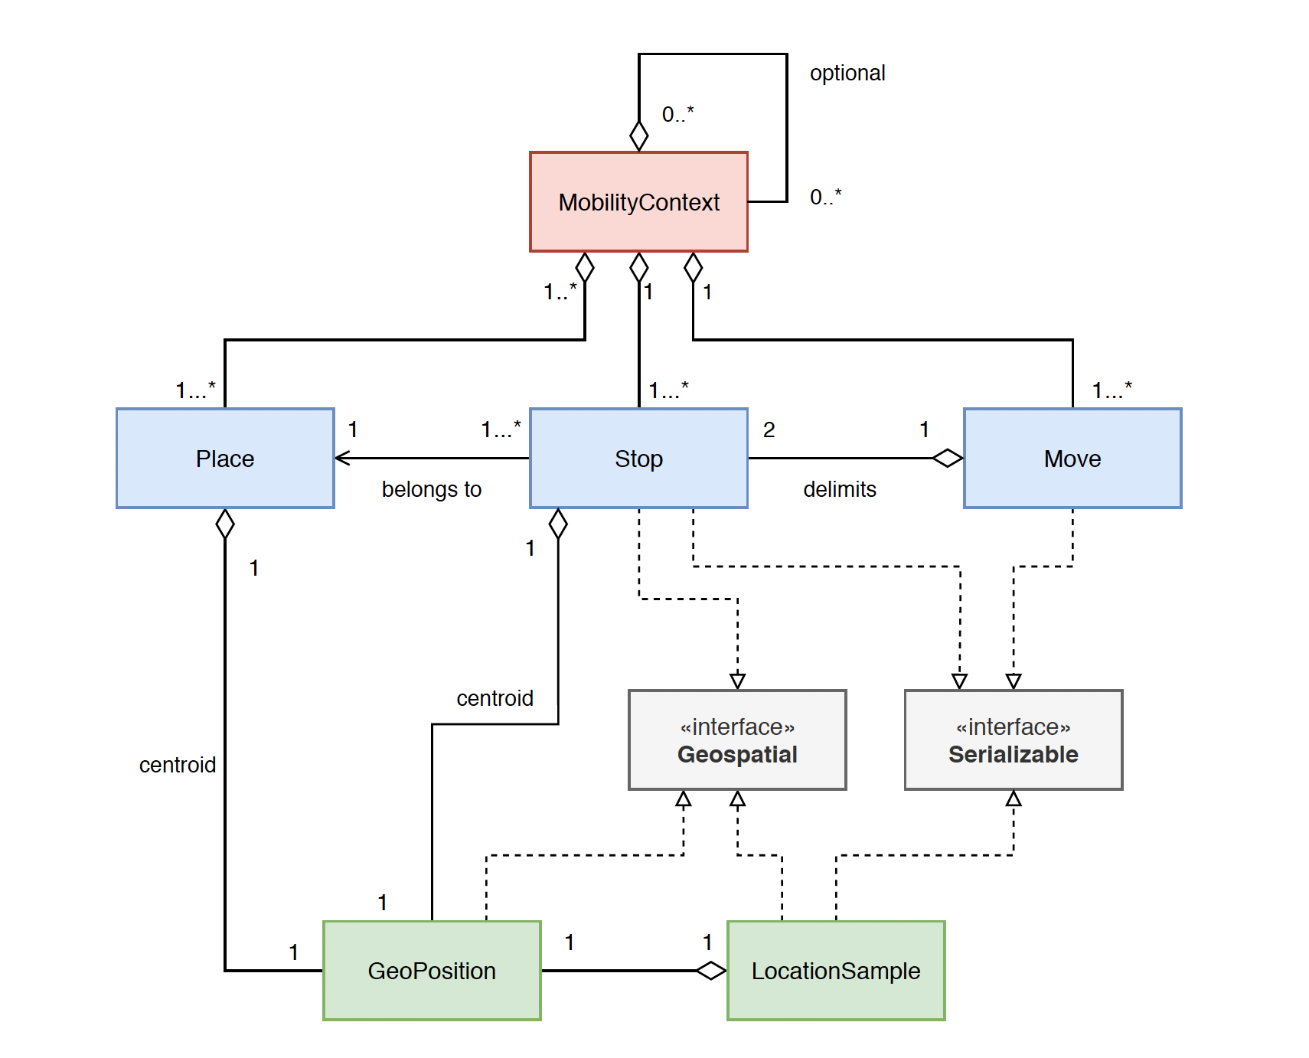
Software Design – Domain Model

Slide 36
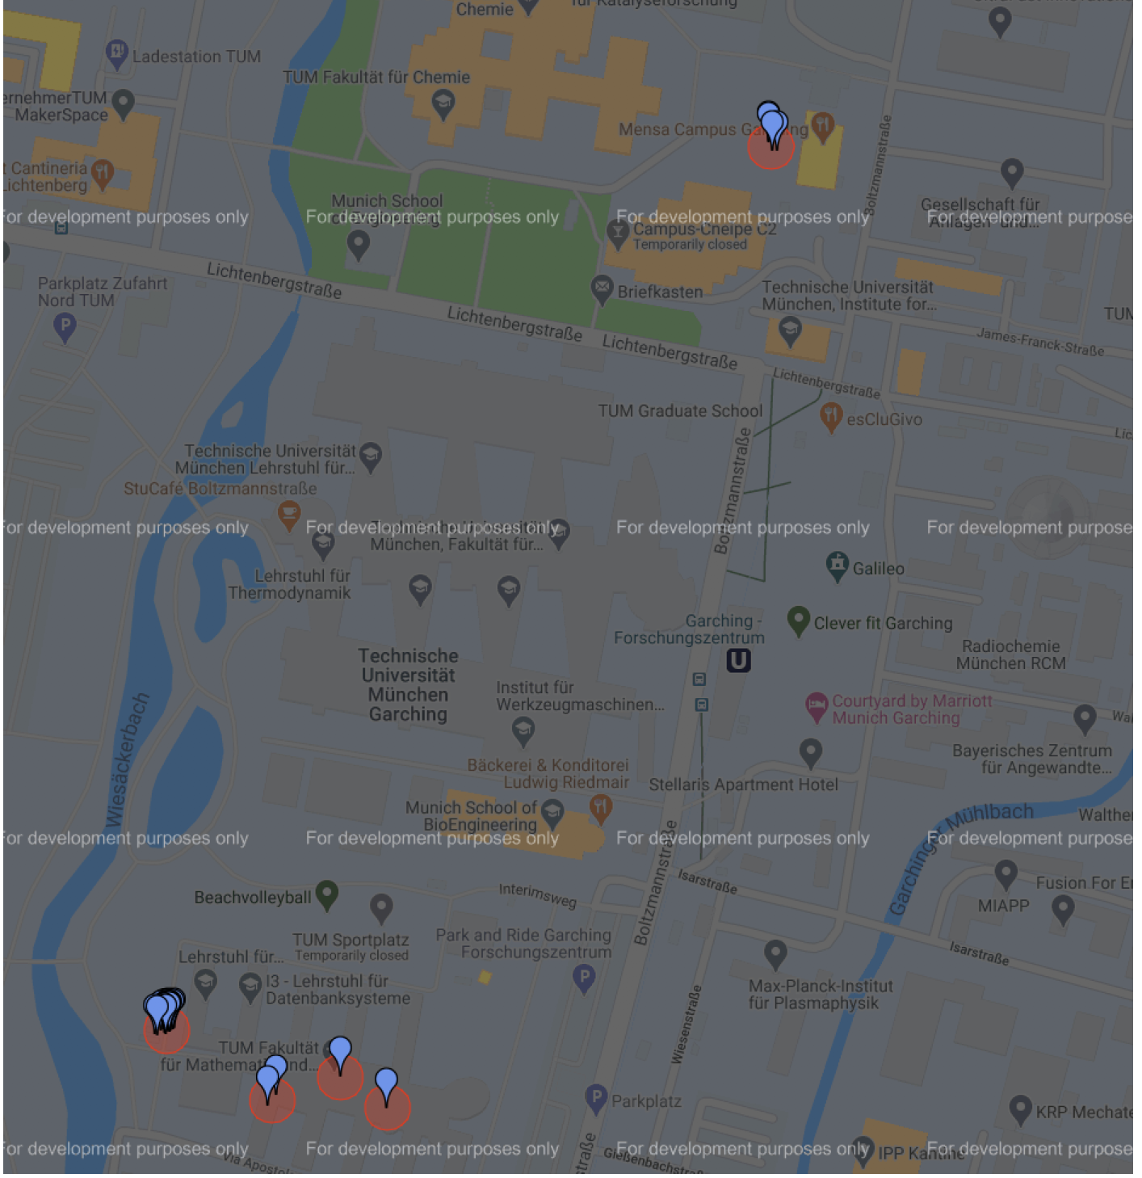
Self-Study
TUM – Campus Garching
Large university building, many offices
Place radius was set to 25 meters
Offices were discovered as places
Bornholm/Copenhagen
Noise in the data would create multiple places for home
Not interested in smaller places
Place radius was se to 50 meters

Slide 37
Field Study
10 participants, 3 weeks (April – May 2020)
Custom Study app (iOS)
Distributed via Apple Testflight
Tracked location data, computed features
Prompted a daily questionnaire
Questionnaire
[Number of Places] How many unique places (including home) did you stay at today?
[Home Stay] How many hours did you spend away from home today? (Rounded-up)
[RI] Did you spend time at places today that you don’t normally visit?
[RI] On a scale of 0-5, how much did today look like the previous, recent days? (Where 0 means ’Not at all’ and 5 means ’Exactly the same’)

Slide 38
Field Study Application (Diary)

Slide 39
Field Study – What Went Wrong
Android Location API was changed
Would have taken longer to get study going
Users were not given a proper introduction
What counts as a place
What is a routine (i.e. places visited)
Don’t turn your phone off during the night

Slide 40
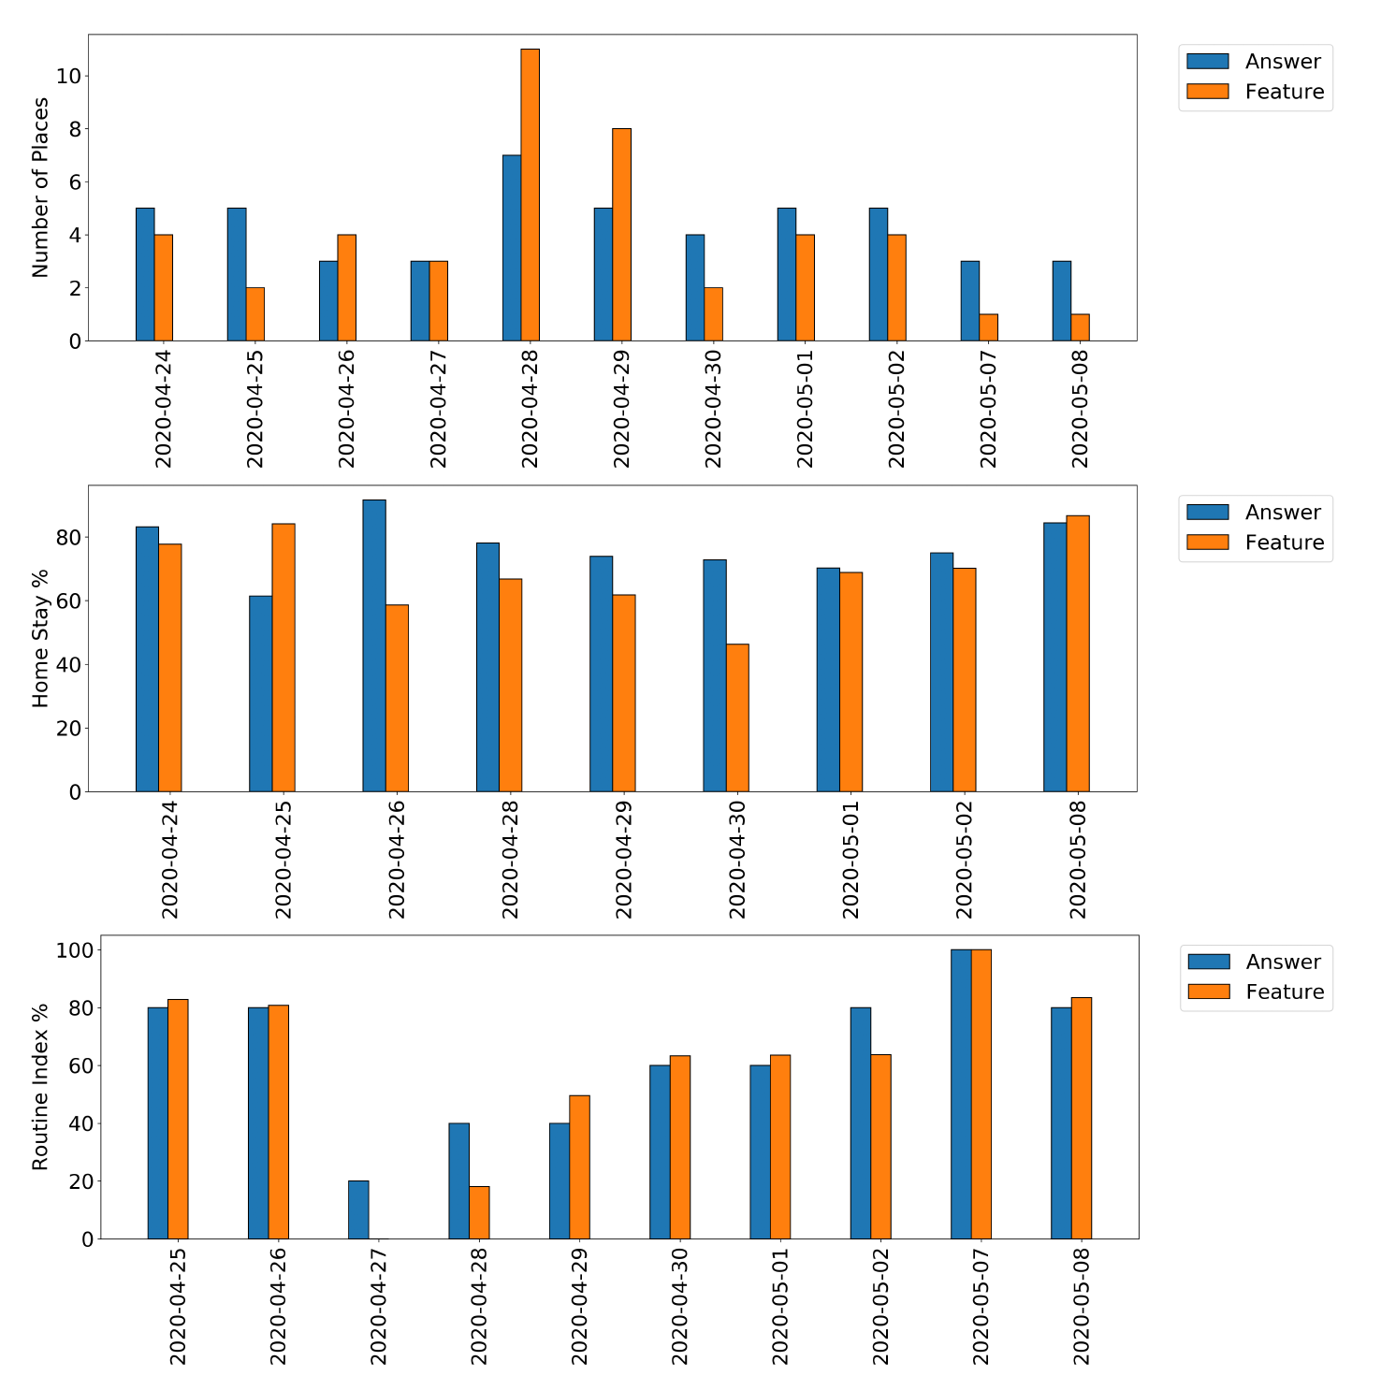
Results – P8’s Features
Also a high correspondance, but not many days of data

Slide 41
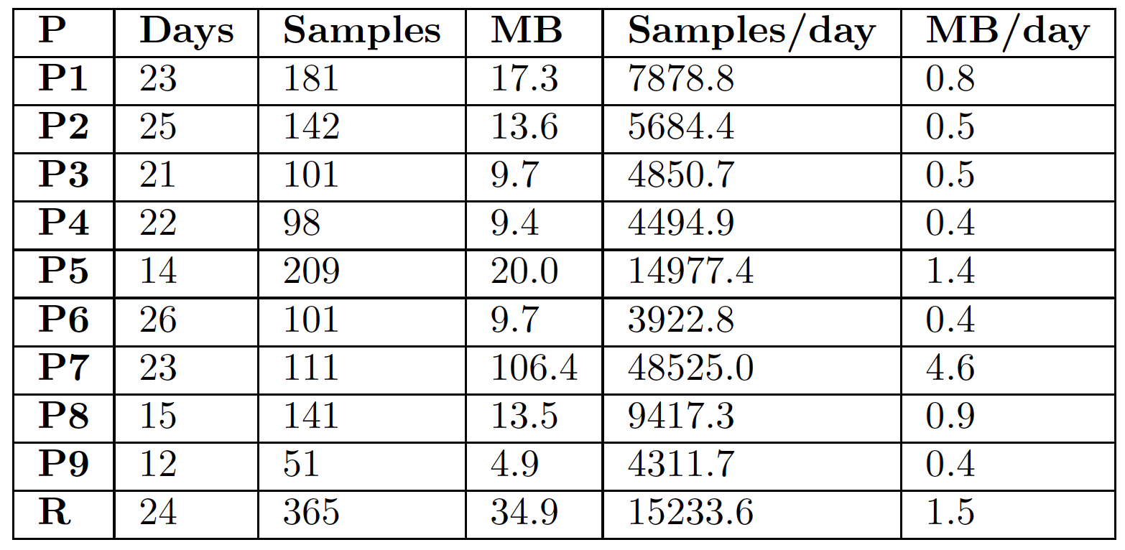
Results – Samples collected
P7 collected magnitudes more data than other participants

Slide 42
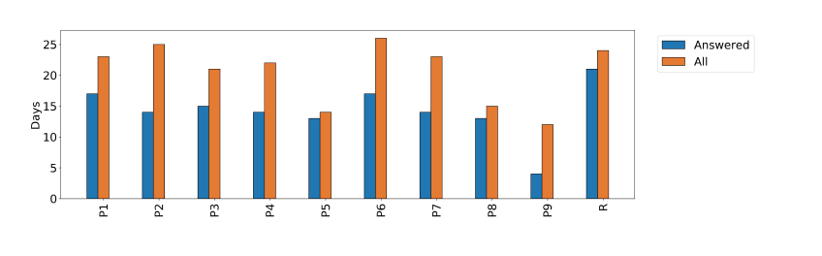

Slide 43
Future Work – Routine Index
Not the same implementation as Saeb/Palmius or Canzian
Current implementation is simpler, but not clinically evaluated
Solution #1: evaluate clinically
Solution #2: implement the same RI as Saeb et al.
Distinguish between weekends and weekdays
Inspired by Palmius et al.
Can be done for all features

Slide 44
Future Work – Parameter Tuning
Parameters
Stop radius
Stop duration
Place radius
If ground truth dataset available, it’s a machine learning task
Labels = mobility features

Slide 45
Future Work – Optimized Computation
Context generation currently not an async function
Programmer has to provide several lines of code to do this
If not async, UI will freeze
Lazy evaluation delays computation of scalar features
Only Stops, Moves and Places are computed in the generate() method
Features are not computed before their getter method is called

Slide 46
Future Work – CARP Mobile Sensing
An integration for the ’Context Package’
Currently the package supports
Location racking
Activity recognition
Weather
Geofencing
Air Quality Index

Slide 47
References
Saeb2015 Sohrab Saeb et al. “Mobile Phone Sensor Correlates of Depressive Symptom Severity in Daily-Life Behavior: An Exploratory Study”. In: Journal of Medical Internet Research 17 (July 2015). doi: 10.2196/jmir.4273.
Canzian2015 Luca Canzian and Mirco Musolesi. “Trajectories of Depression: Unobtrusive Monitoring of Depressive States by Means of Smartphone Mobility Traces Analysis”. In: Proceedings of the 2015 ACM International Joint Conference on Pervasive and Ubiquitous Computing. UbiComp ’15. Osaka, Japan: Association for Computing Machinery, 2015, pages 1293– 1304. isbn: 9781450335744. doi: 10.1145/2750858.2805845. url: https: //doi.org/10.1145/2750858.2805845.
Palmius2017 N. Palmius et al. “Detecting Bipolar Depression From Geographic Location Data”. In: IEEE Transactions on Biomedical Engineering 64.8 (2017), pages 1761–1771. Cuttone2014 Andrea Cuttone, Sune Lehmann, and Jakob Eg Larsen. “Inferring Human Mobility from Sparse Low Accuracy Mobile Sensing Data”. In: Proceedings of the 2014 ACM International Joint Conference on Pervasive and Ubiquitous Computing: Adjunct Publication. UbiComp ’14 Adjunct. Seattle, Washington: Association for Computing Machinery, 2014, pages 995–1004. isbn: 9781450330473. doi: 10.1145/2638728.2641283. url: https://doi.org/10.1145/2638728.2641283.

